Slide 1
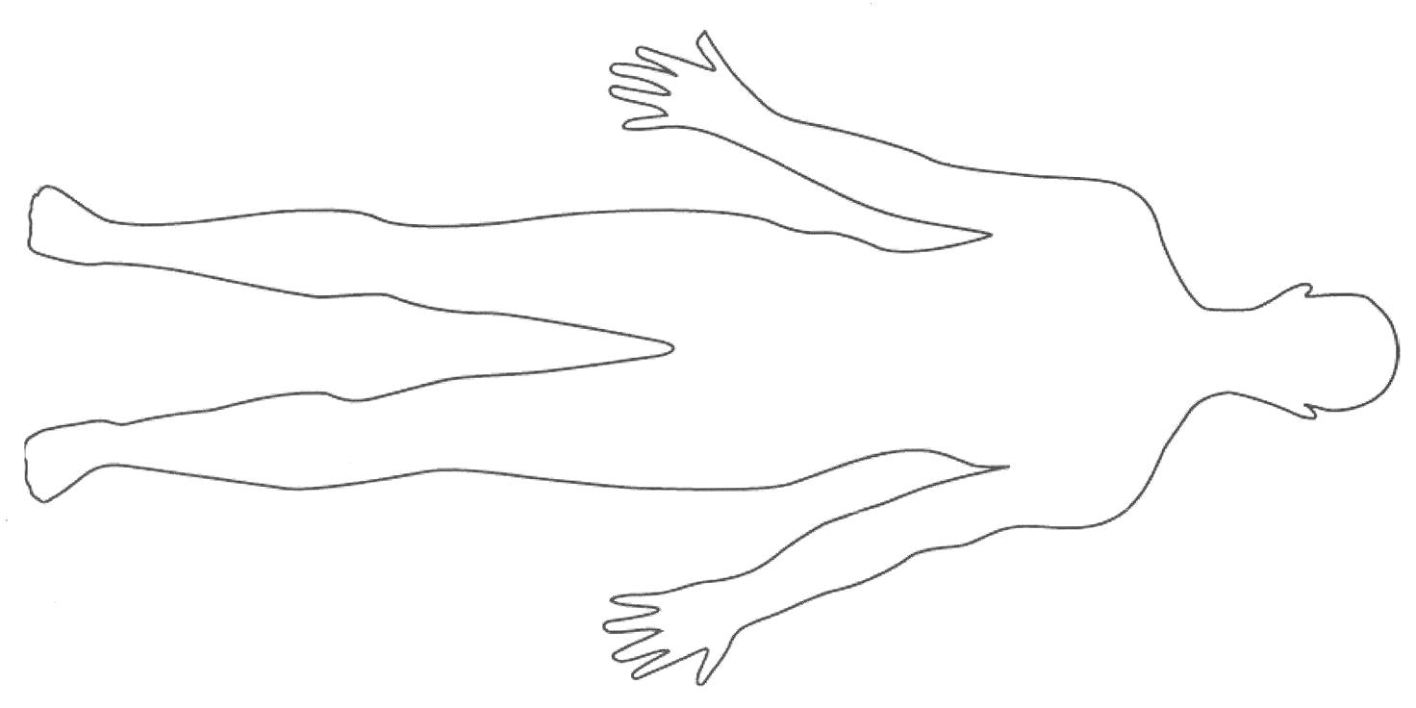
Scaled down from real system by a factor of 5 : 1
5cm in real life = 1cm in powerpoint
2cm square
Sensor topology with pressure heatmap
10 cm
10 cm
90 cm
190 cm

Slide 2
Scaled down from real system by a factor of 5 : 1
5cm = 1cm in powerpoint
2cm square
10 cm
5 cm

Slide 3
Scaled down from real system by a factor of 5 : 1
5cm = 1cm in powerpoint
10cm real life square
Sensor topology with pressure heatmap
10cm
10cm
90cm
100cm
190cm
200cm

Slide 4
Scaled down from real system by a factor of 5 : 1
5cm = 1cm in powerpoint
Sensor topology with pressure heatmap

Slide 5
Scaled down from real system by a factor of 5 : 1
5cm = 1cm in powerpoint
Staggered Sensor topology with pressure heatmap
10cm real life square
10 cm
10 cm
90 cm
190 cm

Slide 7
1kOhm
D0 D1 D2 ……….. D18
SN74HC595N Shift Registers
ADC0 ADC1 ADC2 .…….... ADC8
Atmega32U4 Microcontroller

Slide 8


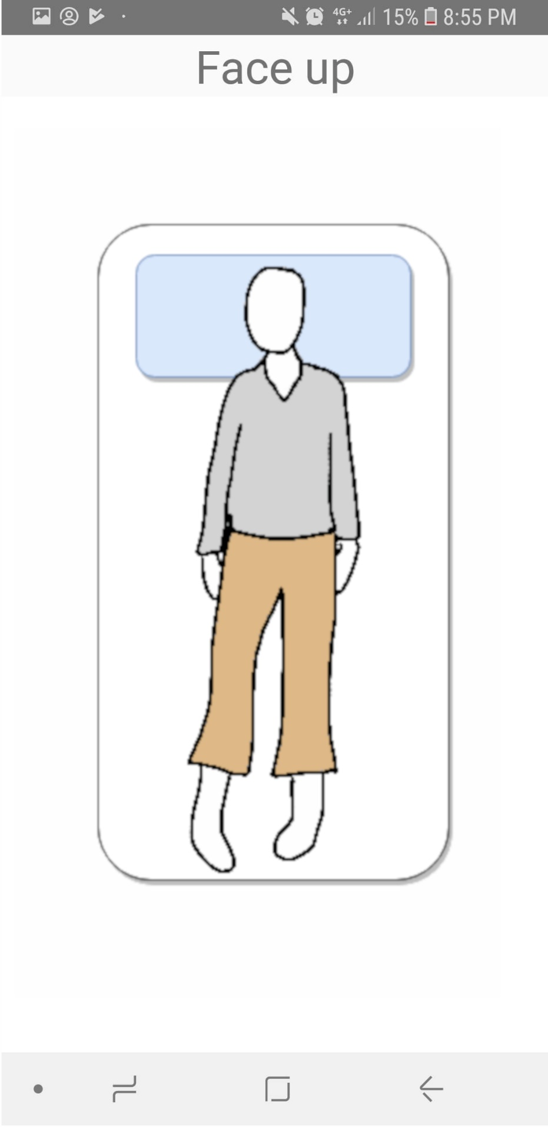
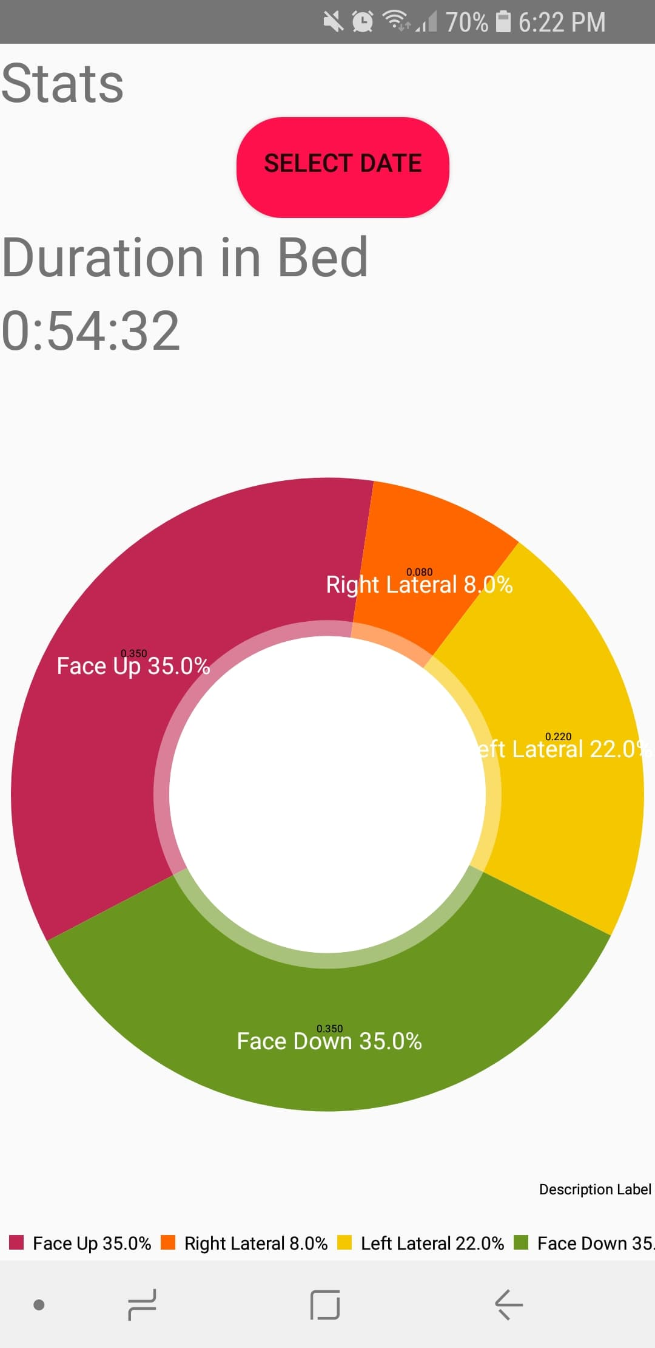


(a) Login
(b) Dashboard
(c) Live Posture Monitor
(d) Posture Breakdown
(e) History Date Selection
(f) Fall Warning

Slide 9
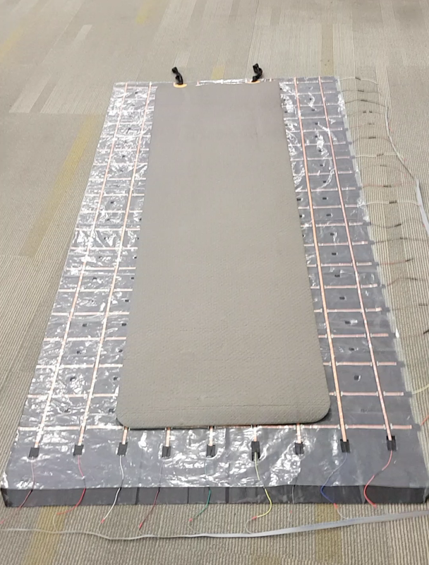
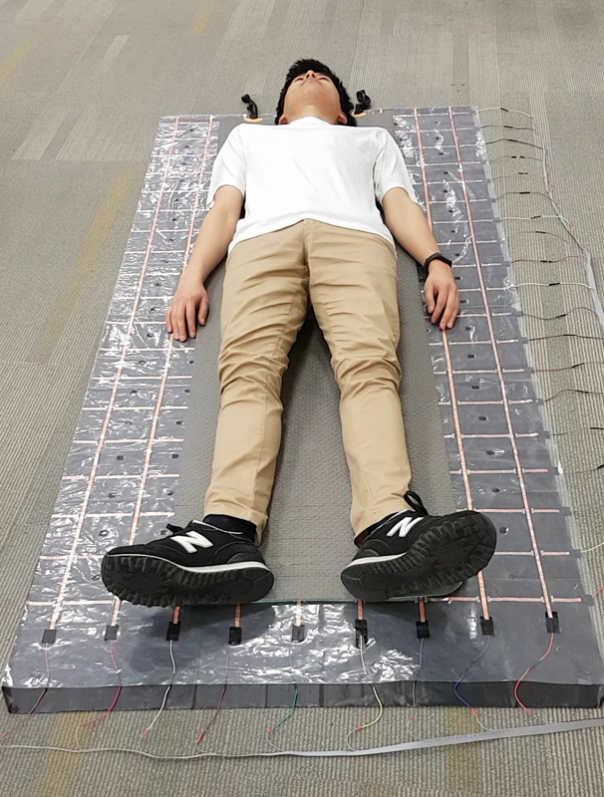
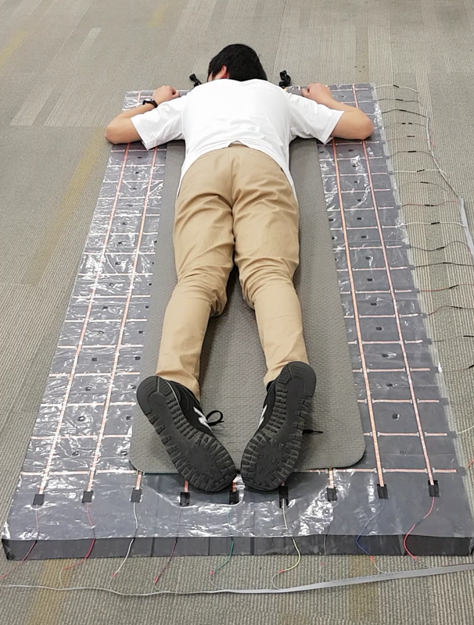
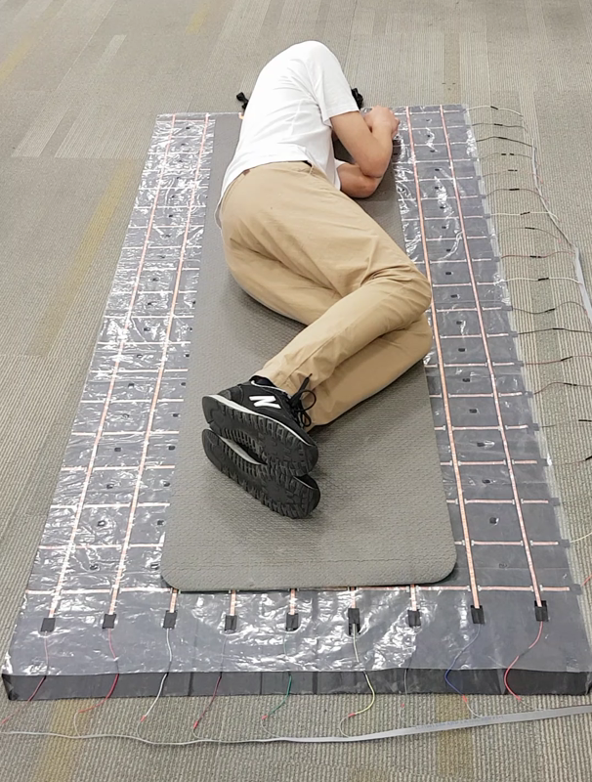
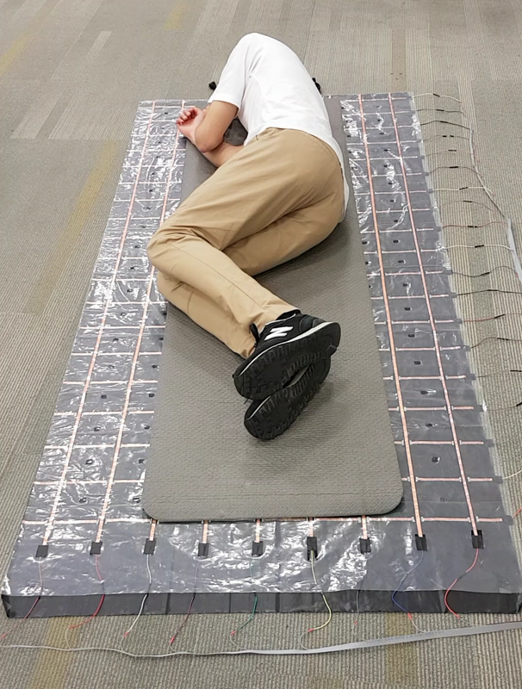
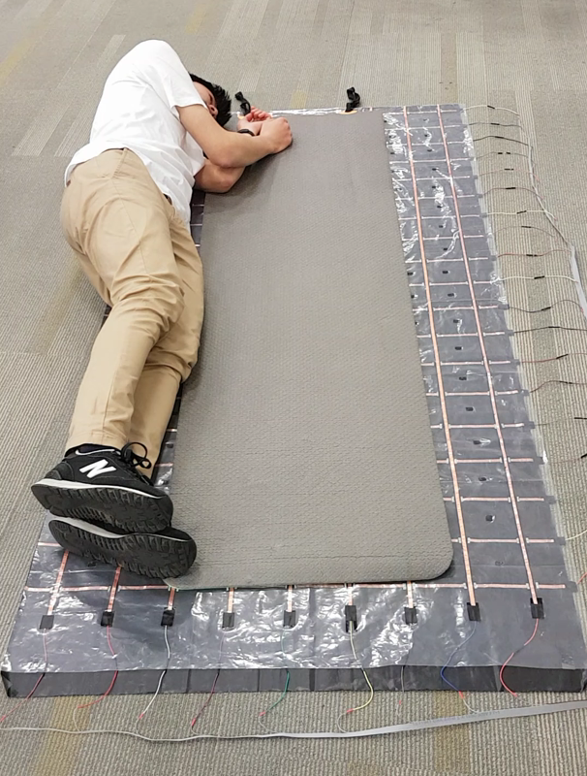
(a) Unoccupied
(b) Face up
(c) Face down
(d) Left lateral
(e) Right lateral
(f) Edge detection

Slide 10
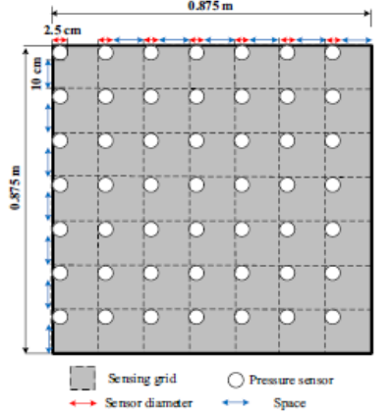
184 cm
9.4cm
9.4cm
9.4cm
92 cm
9.4cm
2 cm
2 cm
Sensing Grid
Pressure Sensor

Slide 11
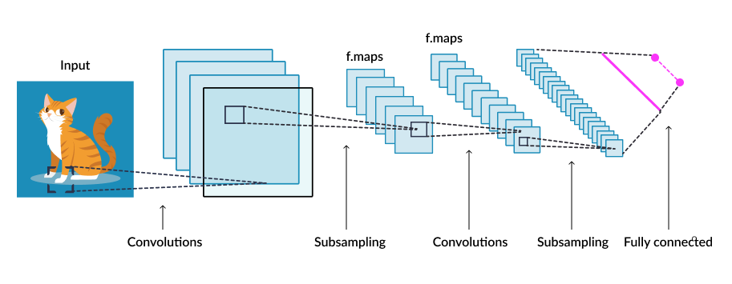
f.maps
f.maps
Convolutions
subsampling
Convolutions
subsampling
Fully Connected

Slide 12
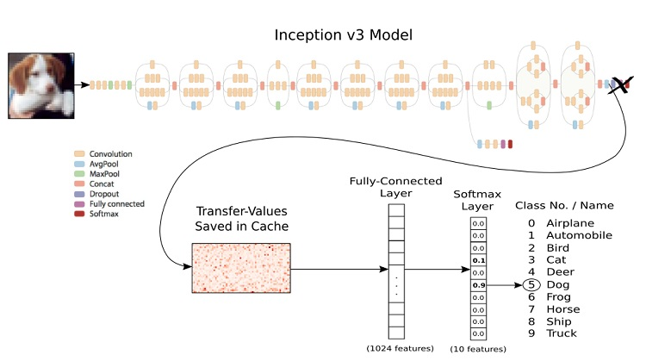

Fully-Connected Layer
Softmax
Layer
Class
#
Class Name
Transfer-Values Saved in Cache
0.0
0
Unoccupied
0.07
1
Face Up
.
.
.
2
0.90
Face Down
0.02
3
Left Lateral
0.01
4
Right Lateral
0.0
5
Edge
1204
Features
6 Features

Slide 13
(a) Login
(b) Dashboard
(c) Posture Breakdown
(d) History Date Selection

